Slide 1
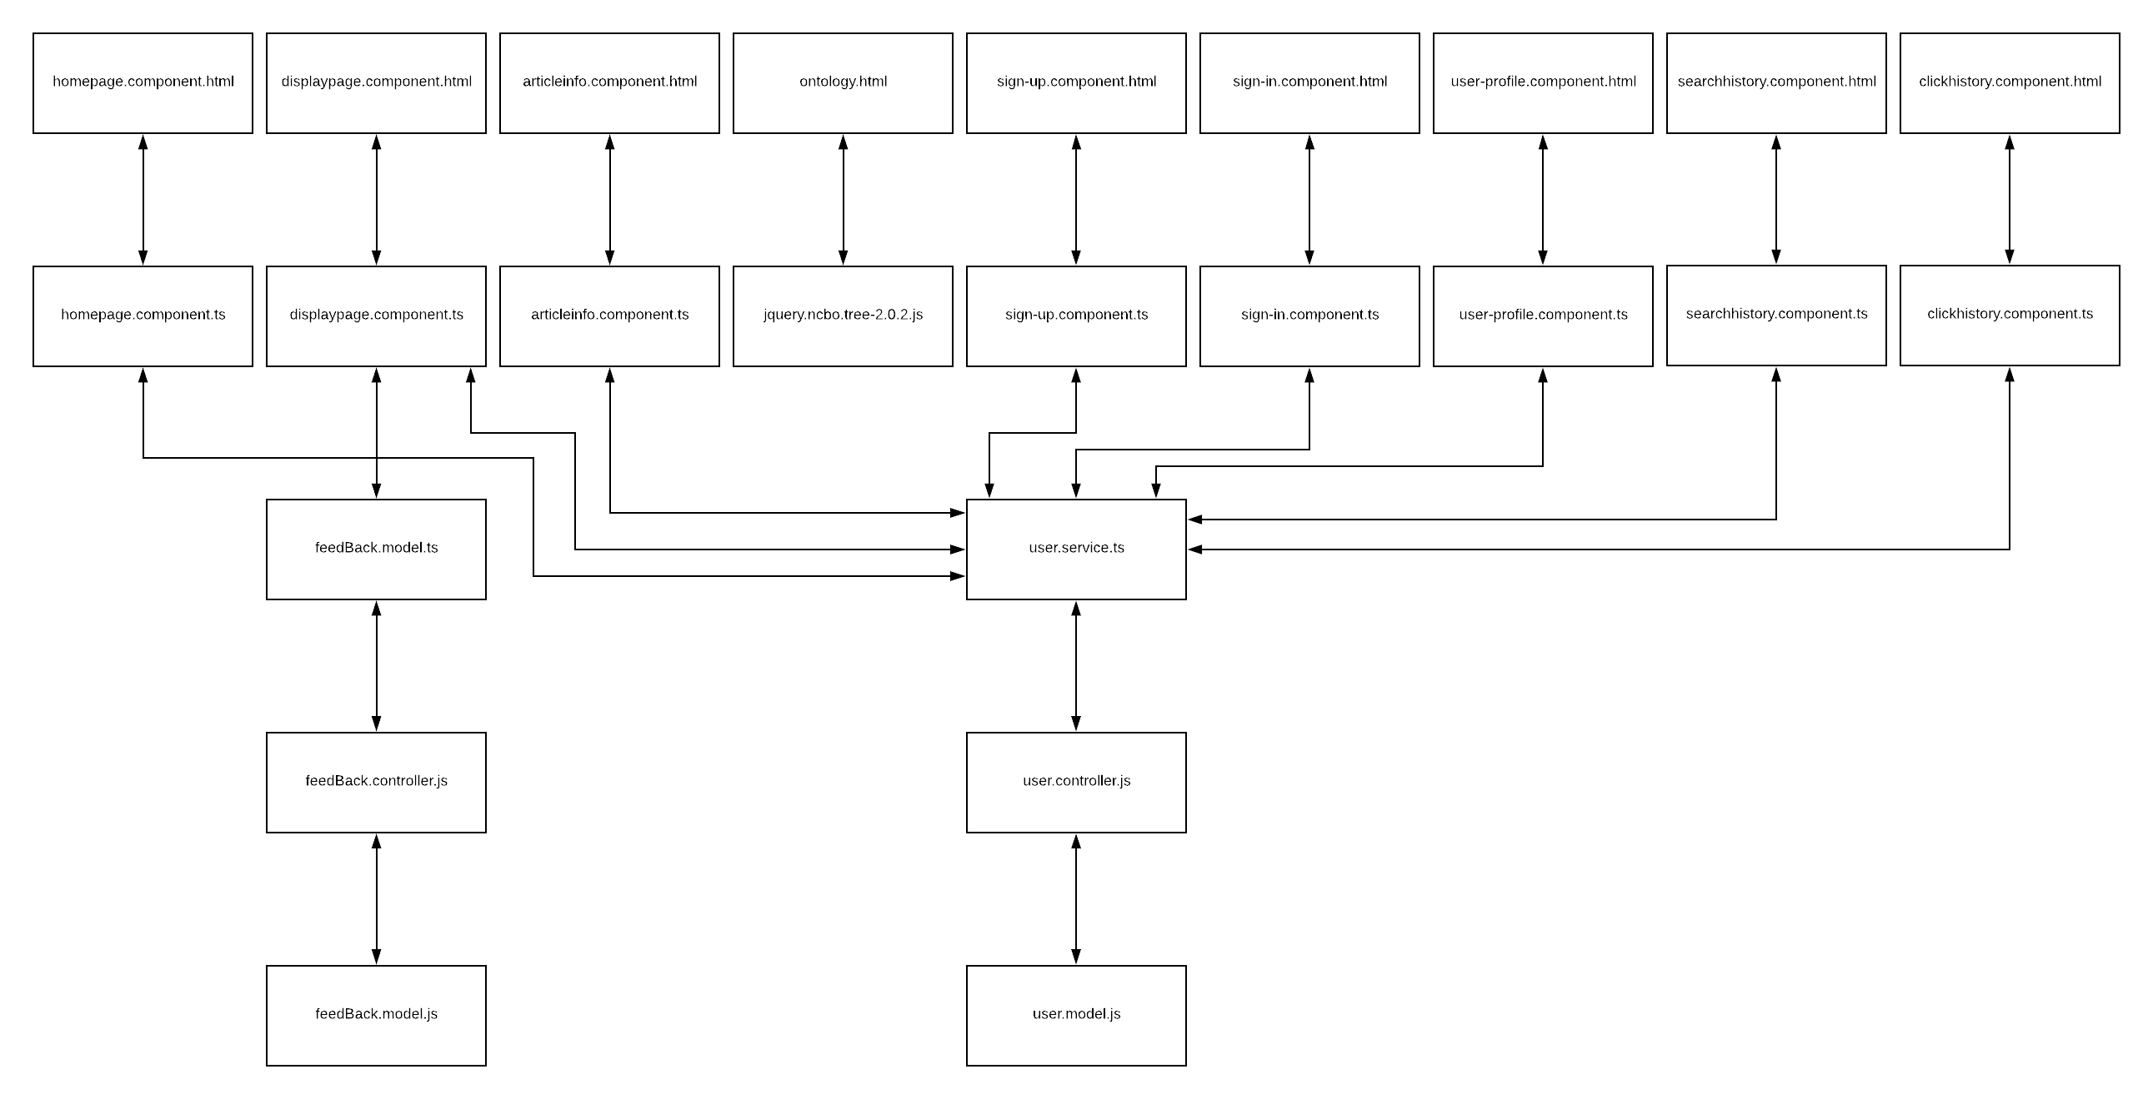
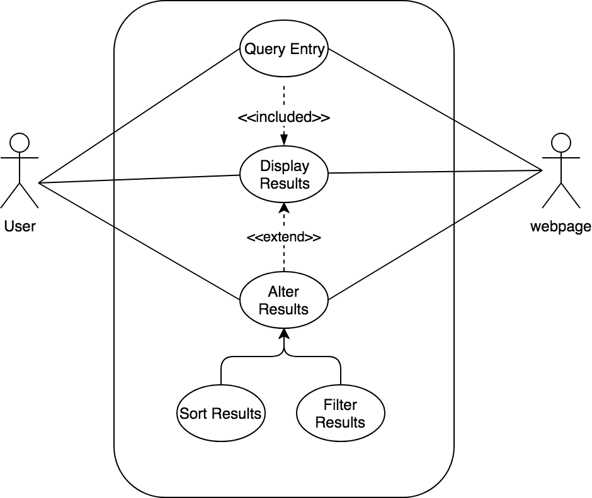
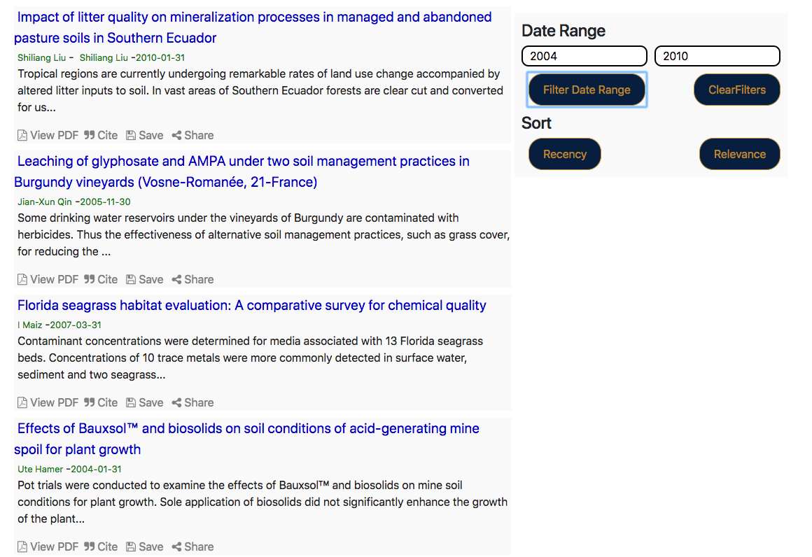
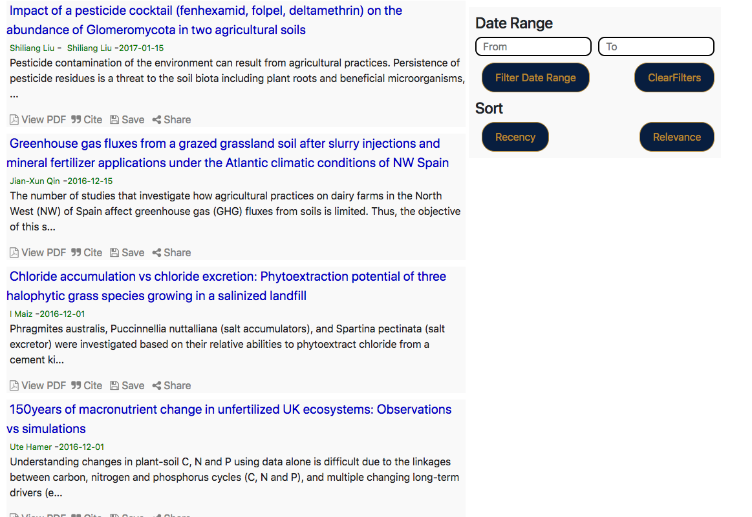










Fall 2018 Senior Design Project EnvoScholar 1.0 Students: Andrew Castillo, Florida International University Mentor: Mark Finlayson, Florida International University Instructor: Dr. Masoud Sadjadi, Florida International University
Problem
Current System
Requirements
Today, semantic search is a newer concept seeking to understand user’s intents by adjusting searches based on the contextual meaning of words and terms. With the rise of websites such as Semantic Scholar, the surface of semantic search is being broken. Currently there is no platform to search via a semantic search for environmental scientific articles. EnvoScholar is here to change that.
Once navigated to the EnvoScholar homepage a user enter a query which will be sent to the backend and provide results on a new page. Here the user can manipulate the results via sorting and filtering (specifically by date range). Cross-compare their search results via Microsoft Academic or Semantic Scholar, while applying the filter. The filtering is done after the JSON file is returned via the front-end. The user may also choose to leave feedback for the website which is stored in the MongoDB database.
The UI must be web-based, cross-browser, cross-platform, and interactive. Contain a log-in feature that users can view and interact with their accounts. In turn it will contain their information as well as their search history, include a search feature that interacts with the existing backend search. Users can also view search results backend by database query of indexed articles. Contains a view of concepts returned by a query analysis algorithm, and enables users to sort and filter results.
Class Diagram
Object Design
Example Sequence Diagram: Sort and Filter
Example Use Case Diagram: Sort and Filter
Implementation
Angular 6 was used to create the functionality of the front end.
HTML5, CSS, and Bootstrap Studio were used to style and edit the front end. Elasticsearch was used to enhance the GET requests to the PostgreSQL database containing the articles. NodeJS and Express were used to create the server that connects to the Mongo Database containing the users.
Screenshots
Summary
Filter
Sort
In EnvoScholar 1.0 my partner and I successfully implemented basic functionality creation of a personalized profile, searching, manipulating results and providing the users with the most desired articles. Version 1.0 is just the beginning for EnvoScholar, my partner and I came from knowing very little web development and project management to absolutely thriving in both fields with true passion. EnvoScholar has a long way to go but we believe a successful project always starts with a great foundation.
Verification
System Design
Example for Sort and Filter
Test case ID: NVOS-7 Sort and Filter
Description/Summary of Test: Sort by recency and filter given date ranges
Pre-condition: Displayed results list given a query
Expected Results: Successful sorting and filtering
Actual Result: Successful sorting and filtering
Status (Fail/Pass): Pass
The material presented in this poster is based upon the work supported by Dr. Masoud Sadjadi and Dr. Mark Finlayson. I thank Bryan Bastida, Maria Presa, and Deya Banisakher for assistance, cooperation and mentorship that I received throughout this process

